Slide 1

Squash Niagara
Prototype I Meeting
NEXT:
Agenda

Slide 2
Agenda
Introduce Team members - (name)
Sitemap - (name)
Data Model- (name)
Prototype I - (name)
Working Progress – (name)
Q&A

Slide 3
UML
Sitemap
By Name

Slide 4
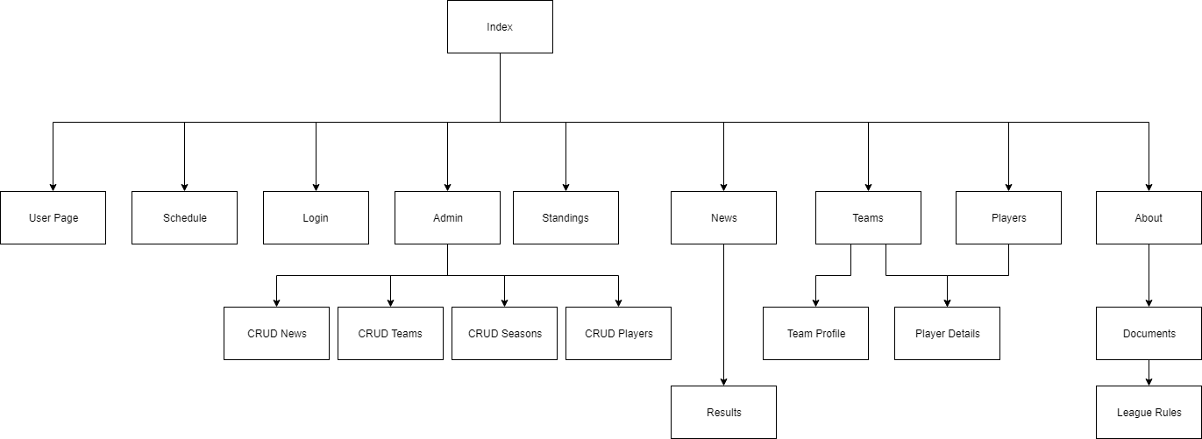

Slide 5
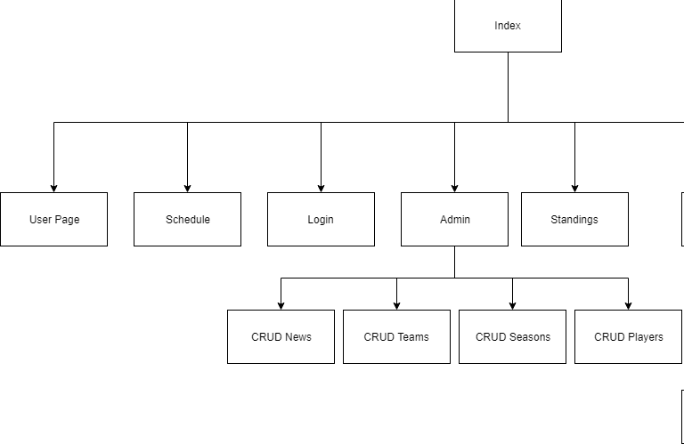

Slide 6
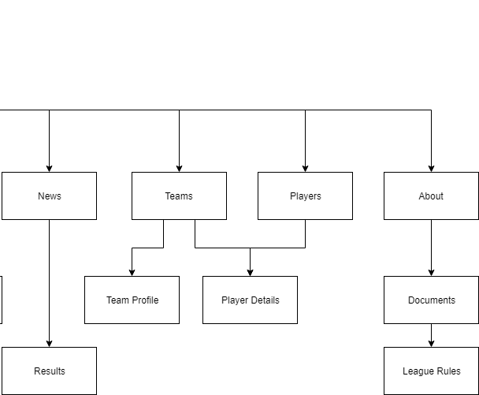

Slide 7
UML
Data Model
By Name

Slide 8
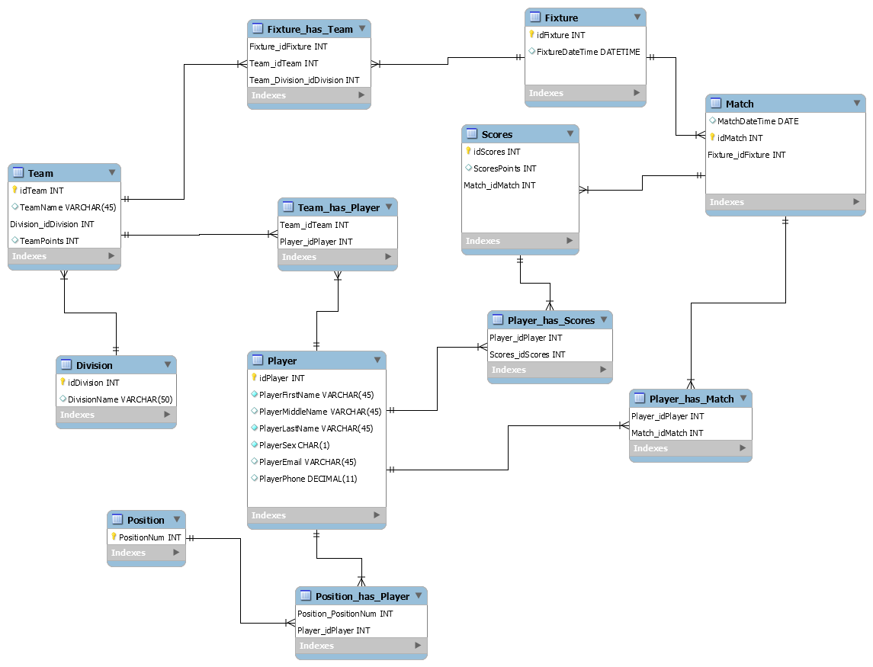

Slide 9
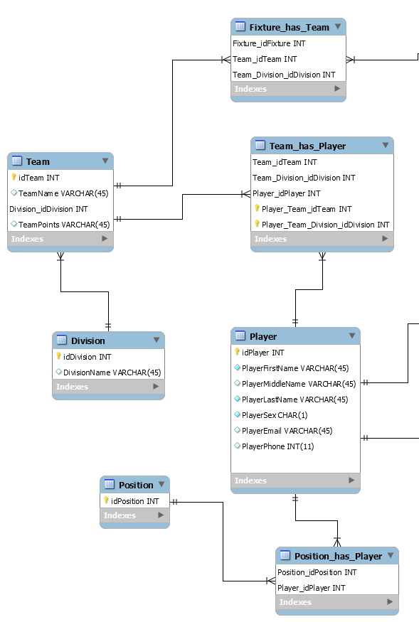

Slide 10
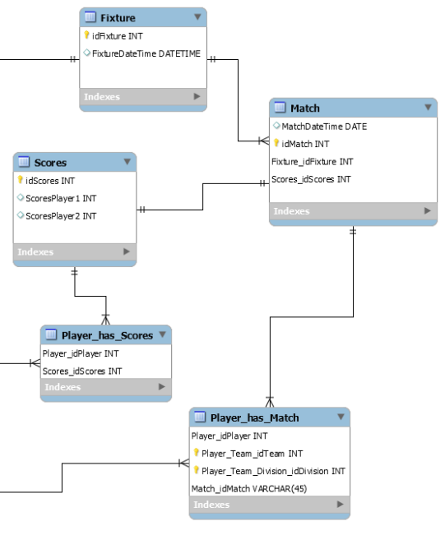

Slide 11
UML
Prototype I
By Name

Slide 12
UML
Working Progress
By Name

Slide 13
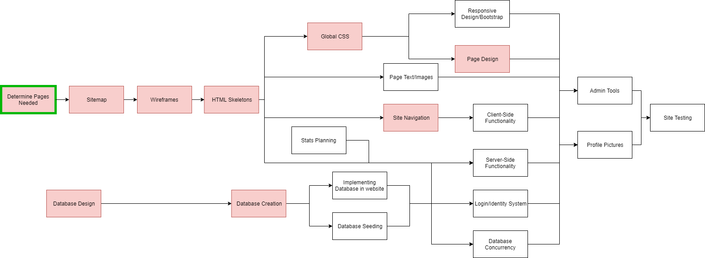

Slide 14
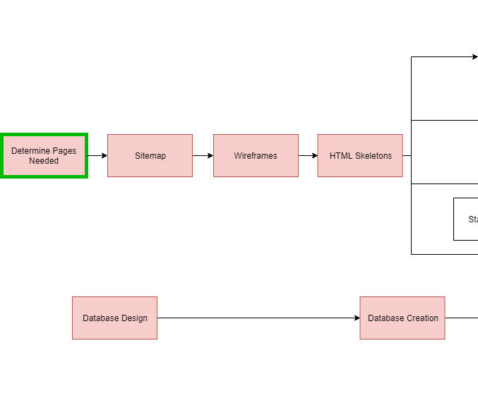

Slide 15
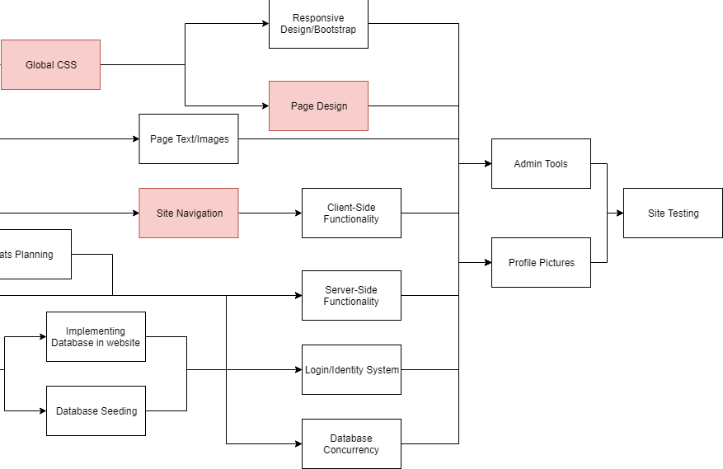

Slide 16
Q&A

